Slide 1
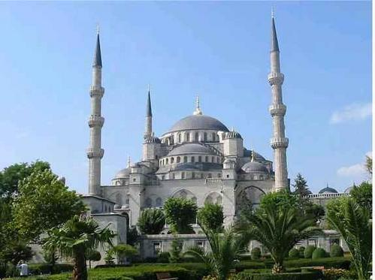
Islam in Brief
By:
Mohammed A. Al-Abdulhay
Petroleum Engineer-Saudi Aramco
Notes:
good day ladies and gentlemen,
My name is MAA I work in SA as PE
Today it is my pleasure and glad to share with you my great topic and together to fly on the truth sky.
I am sure 100%, that by the end of this topic I will add great values to you and I will give you that candle which will guide to the light and happiness.
Before beginning, I advise you to listen carefully and pay full attention

Slide 2
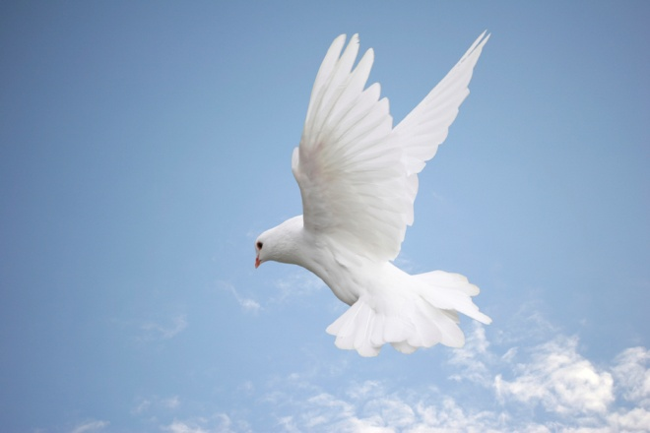
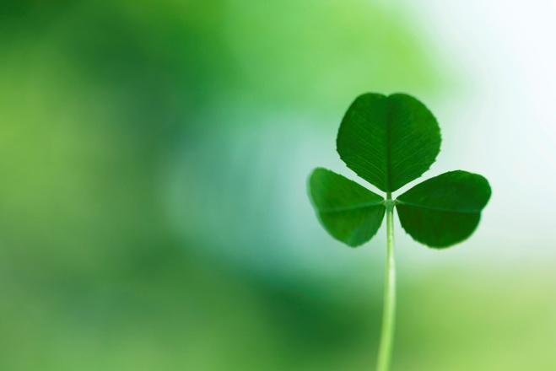

Introduction…..
What is Islam?
Islam is derived from the Arabic root "Salam": peace, purity
Religious meaning: submission to the will of God and obedience to His law
Islam is not a new religion, the same truth that God revealed through all His prophets
Prophets Tree
Islam's message has been reformed in the last stage thru messenger, (Muhammad)
Muslims follow the religion of peace, mercy, and forgiveness
Notes:
Now what is Islam? I want an answer from you
Islam came from Arabic word “ Salam” which means; peace/purity. So the greeting of Islam is “Assalamu Alaikum” means peace be upon you.
In religion term→ submission you will to the will of God and obedience His law which has never conflict in all life aspects. By being Muslim you can be engineer, doctor, teacher, go for travel, run the routine life task for both male and female.

Slide 3
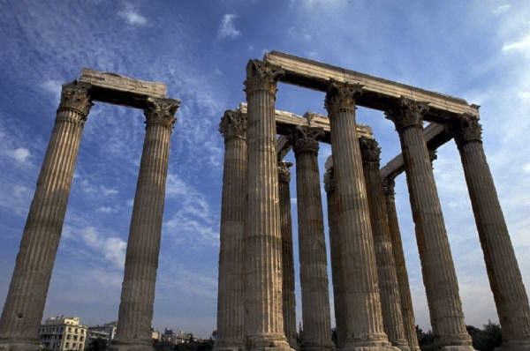
The Religion of Islam

Slide 4

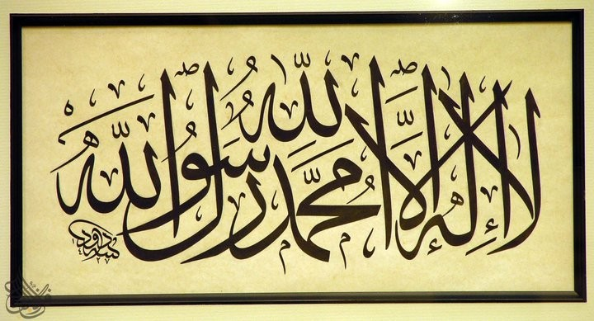
1st Pillar
The Declaration of Faith
What is it?
There is non worthy of worship except Allah and Muhammad is the messenger of Allah.
أشْهَدُ أنَّ لا إلهَ إلا الْلَّهِ وَأشْهَدُ أنَّ مُحَمَّدً رَسُوْلُ الْلَّهِ
Testimony of faith = (Shahadah)
Allah has no partner, no son
It is a key to enter Islam
To say this in Arabic :
“Ashhadu Alla Ilaha Illa Allah Wa Ashhadu Anna Muhammad Rasulu Allah”

Slide 5
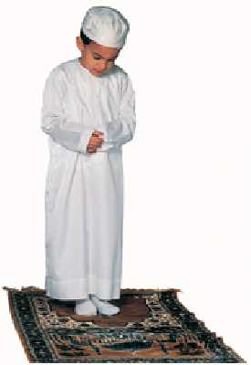
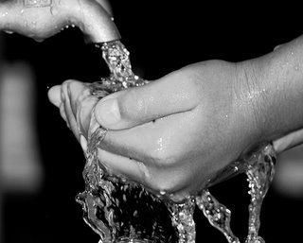
2nd Pillar
Performing Prayers
What is it?
They are five prayers at five times. Prayer in Islam is a direct link between the mankind and Allah. Each prayer does not take more than a few minutes to perform.
Strengthen the belief in Allah
Inspire the morality and attitude
Time management
Frequent cleanup and tidy
Athan, call for pray
Notes:
During prayer, you ask Allah for sustaining, forgiveness and help
If you do it in perfect manner, your attitude and behavior will be changed to better mode
It is a good practice in term of controlling your life sleeping, appointment
Before performing prayer, Muslim is requested to cleanup his face, arms, legs, ears, mouth also Muslim requested to wear clean dress and good shape before practicing prayer because he is going to face his Lord. So we can conclude that Muslim always be clean and tidy

Slide 6
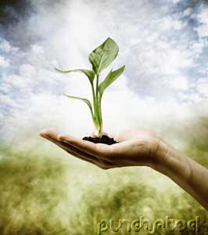
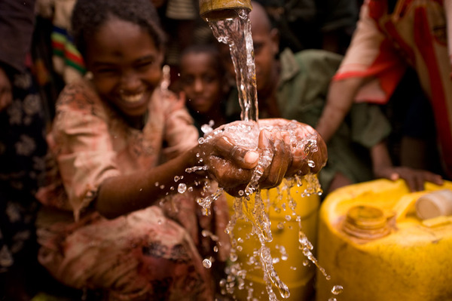
3rd Pillar
Payment of Charity (Zakah)
What is it?
Zakah in Arabic means “grow”, “increase”, and “purifying”. So, actually the act of giving Zakah means purifying the wealth to gain Allah's blessing. Practically, is to give 2.5 % of wealth each year to the poor and needy.
Purify self-heart and wealth
Allah forgives your sins
Frees oneself from love of oneself
Ends poverty as Zakah is given to poor
Reduces crimes
Notes:
As I mentioned, to gain/bring Allah's blessing
By paying Zakah/charity,
Giving Zakah to others means sharing with him your money and help them
Because every one especially the rich has to give charity to poors; 2.5% from me and you and him …so no poverty, no crimes, no thieves (ali baba), no robbery
This enhances the meaning of society bonds

Slide 7
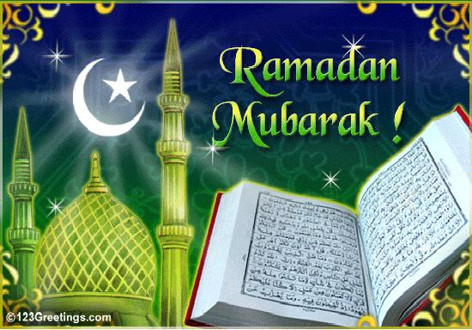

4th Pillar
Fasting The Month of Ramadan
What is it?
During the Arabic month of Ramadan, Muslims are requested to abstain from food, eat, and sexual intercourse from dawn until sunset.
To strengthen the power of self-control and patience
To feel the pain of poor and needy
To stop us from doing sins, bad habits
To improve health
To bring us closer to Allah
Notes:
It is a good lesson to improve your will-power and get control (if you are fast and see ….)
When you become hungry / thirsty, we will really feel about the poor how they live without any food for couples of days this leads to help, support pay money
Because Muslim not requested only to abstain from drink/food but also to abstain from doing bad habit otherwise his fast is not complete.
In the modern medicine, they showed that fasting has many benefit for body health
During Ramadan, Muslim very excellent jobs; giving charity, performing extra prayers, visiting relatives

Slide 8
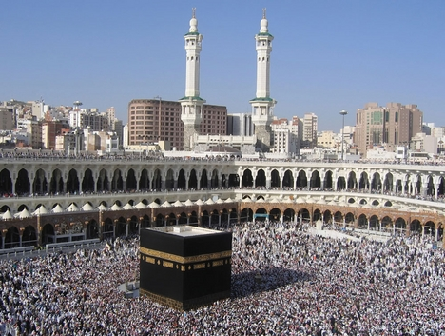
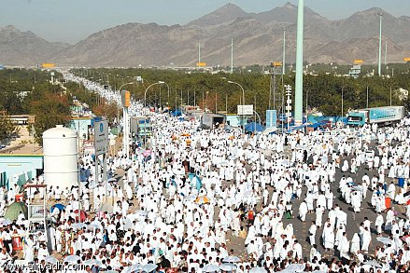
5th Pillar
Pilgrimage (Hajj)
What is it?
It is the holy trip to Makkah once in lifetime if one can afford it physically and financially.
To clean Muslims of all their sins
Makkah is the most sacred place
Teaching noble morals (modesty, patience,.. )
Example of the universal message, equality and unity of Islam
Hajj is a great Islamic conference ; every race, class, and nationality join together
Notes:
Once you have done this pilgrimage in correct way, your all sins will be removed.
this is called Kabah, all Muslim face the direction of kabah for pray
because in order to be your pilgrimage, a pilgrim has to be polite, kind,…
see all the people here are wearing uniform white clothes whoever; king, janitor, engineer, labor, professor,

Slide 9

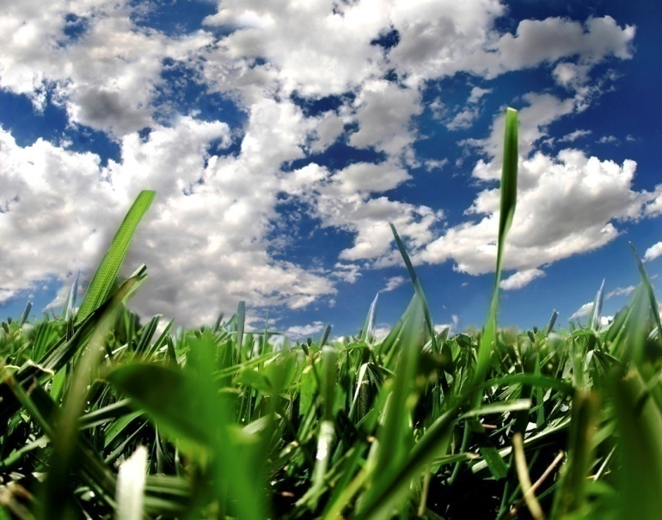
Six Articles of Faith
1st Article
Belief in God
One, unique, incomparable
Has no son nor partner
Only to be worthy of worshipped lonely
He has the most magnificent names and sublime perfect attributes
2nd Article
Belief in the Angels
The existence of the angels
They are honored creatures
The angels worship God alone

Slide 10
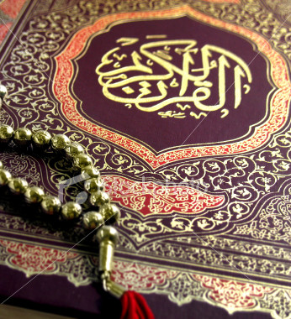
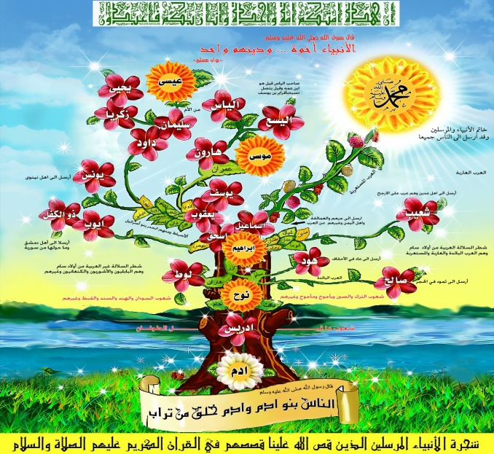
Six Articles of Faith
3th Article
Belief in Revealed Books
Revelations were given to guide the people
The original scripture brought by Prophets
Moses, Jesus, David, Abraham & Mohammad
4th Article
Belief in Prophets & Messengers
All messengers were human beings
Their message is the same
Starting with Adam, Noah, Abraham, Ishmael, Isaac, Jacob, Moses, and Jesus & Muhammad

Slide 11
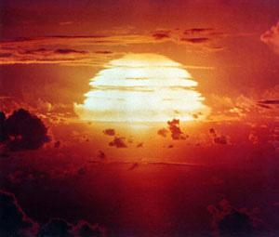

Six Articles of Faith
5th Article
Belief in the Day of Judgment
This will come to an end
All people will be resurrected for judgment
People with good records will be generously rewarded
People with bad records will be fairly punished
6th Article
Belief in Divine Predestination
God knows everything & recorded all actions
Whatever God wills to happen; it will happen
Accept & patience with what Allah has decreed
Our knowledge is limited but His knowledge is limitless
God has given human beings freewill

Slide 12
How can I be a Muslim?
Declaration of Faith
Perform Prayers
Payment of Zakah
Willing to Perform
Five Pillars of Islam
Observe Fasting
Perform Hajj
Believe
Six Articles of Faith
Allah (God)
Angles
Holy Books
Prophets
Judgment Day
Predestination
Say Declaration
of Faith in Arabic
“Ashhadu Alla ilaha illa Allah Wa Ashhadu Anna Muhammad Rasulu Allah”

Slide 13
Thank You…
miswatch@hotmail.com
0503925046

Slide 14
Prophets Tree
back
Adam
Enoch
Ham
Noah
Japheth
Africa
Europe
Shem
Asia
Moses
Ishmael
Isaac
Abraham
Jesus
Moses, Jesus & Muhammad sharing same grandfather
Muhammad

Slide 15
