Slide 1


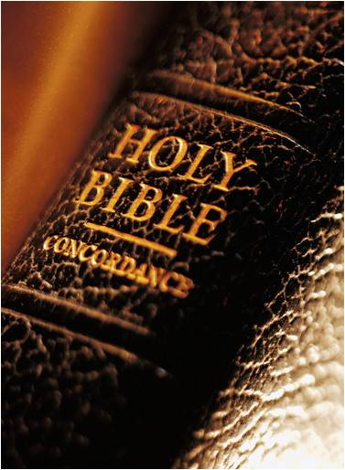
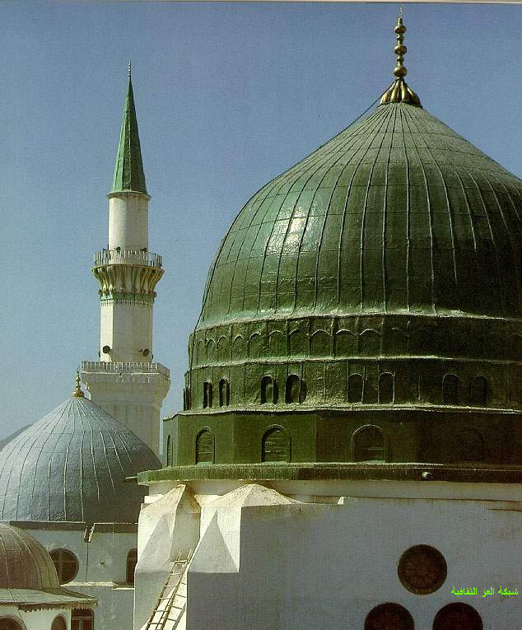
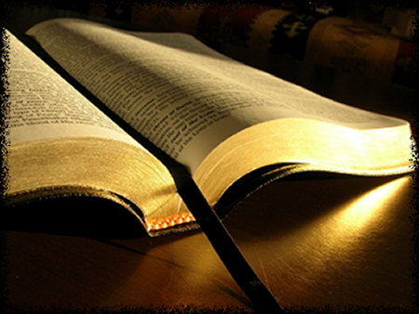
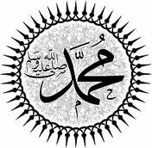
Prophet Muhammad
in The Bible
Prepared by:
Mohammed A. Al-Abdulhay
Petroleum Engineer, 0503925046

Slide 2

Old Testament
Deuteronomy (18:18-19) (King James Version)
(18) I will raise up for them a Prophet like you from among their brethren, and will put My words in His mouth, and He shall speak to them all that I command Him. (19) And it shall be that whoever will not hear My words, which He speaks in My name, I will require it of him. Deuteronomy (18:18-19) (New International Version)
(18) I will raise up for them a prophet like you from among their brothers; I will put my words in his mouth, and he will tell them everything I command him. (19) If anyone does not listen to my words that the prophet speaks in my name, I myself will call him to account

Slide 3
Old Testament
Deuteronomy (18:18-19) (New International Version)
(18) I will raise up for them a prophet like you from among their brothers; I will put my words in his mouth, and he will tell them everything I command him. (19) If anyone does not listen to my words that the prophet speaks in my name, I myself will call him to account
“among their brothers”→ That Prophet will come from the line of the other brother (Ishmael), since Ishmael is the brother of Isaac, who is the forefather of Moses’ people
Prophets Tree

Slide 4
Old Testament
Deuteronomy (18:18-19) (New International Version)
(18) I will raise up for them a prophet like you from among their brothers; I will put my words in his mouth, and he will tell them everything I command him. (19) If anyone does not listen to my words that the prophet speaks in my name, I myself will call him to account
Quran (73:15)
“We have sent to you a Messenger as a witness over you, even as We sent to Pharaoh a Messenger (Moses)”
“like unto thee “→ This implies that the upcoming prophet must look like Moses.
Similarities and differences

Slide 5
Old Testament
Deuteronomy (18:18-19) (New International Version)
(18) I will raise up for them a prophet like you from among their brothers; I will put my words in his mouth, and he will tell them everything I command him. (19) If anyone does not listen to my words that the prophet speaks in my name, I myself will call him to account
Isaiah (29:12)
" Or if you give the scroll to someone who cannot read, and say, "Read this, please," he will answer, "I don't know how to read.“
The promised Prophet will speak whatever is revealed to him.
The promised Prophet will be unlettered.
Notes:
It is well known that the words of God which is the Holy Quran was truly put into Muhammad’s mouth by the Angel Gabriel when the Muhammad received the revelation. This happen when he was 40 years old.
It is well known for any Muslims and even through the history of Mohammed that he was unlettered i.e. he can’t read and write. If you read the biography of Mohammed, you will find this information.

Slide 6
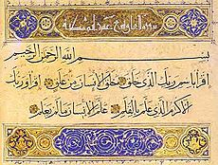
Old Testament
Deuteronomy (18:18-19) (New International Version)
(18) I will raise up for them a prophet like you from among their brothers; I will put my words in his mouth, and he will tell them everything I command him. (19) If anyone does not listen to my words that the prophet speaks in my name, I myself will call him to account
→If we look to the Holy Quran, we will find that all its chapters, except Chapter 9, begin with the phrase, “In the Name of God, the Most Gracious, the Most Merciful.”
Notes:
It is mandatory for all Muslim to say the name of God at least 34 times a day

Slide 7
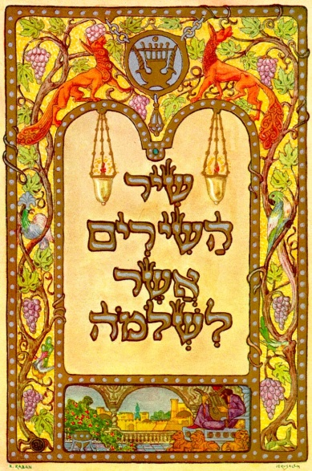
Old Testament
Song of Solomon (5:16) (Original Hebrew Language)
"Hikko Mamittakim we kullo Muhammadim Zehdoodeh
wa Zehraee Bayna Jerusalem.“
Song of Solomon (5:16) (New English Version)
“His mouth is sweetness itself; he is altogether lovely. This is my lover,
this my friend, O daughters of Jerusalem.”
In the Hebrew language ; (im) is added for respect.
Here (im) is added after the name of Prophet Muhammad
which becomes Muhammadim.
Notes:
Song of Solomon is one of old testament which was in Hebrew language.
In English translation they have even translated the name of Prophet Muhammad as "altogether lovely", but in the Old Testament in Hebrew, the name of Prophet Muhammad is present.

Slide 8
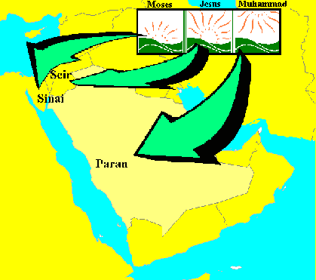
Old Testament
Deuteronomy (33:02)
He said: "The Lord came from Sinai and dawned over them from Seir; he shone forth from Mount Paran. He came with myriads of holy ones from the south, from his mountain slopes“
Genesis (21:19-21)
"(19) Then God opened her eyes and she saw a well of water. So she went and filled the skin with water and gave the boy a drink. (20) God was with the boy as he grew up. He lived in the desert and became an archer. (21) While he was living in the Desert of Paran, his mother got a wife for him from Egypt.
Quran (95:01-04)
“ By the Fig and the Olive,(1) by the Mount Sinai, (2) by this secure city (Makkah), (3) We have indeed created man in the best of moulds (4)
Notes:
Sinai, is the place where the Prophet Moses spoke to God and received the Torah.
Seir, is a place in Palestine where the Prophet Jesus received Divine Revelation
Paran, is a mountain in Makkah where Abraham left Hagar and Ishmael. In that valley of Makkah, the Prophet Muhammad raised up and received revelation.
Fig and the Olive, is the place of prophet Jesus where Prophet Jesus used to deliver his sermons)
Mount Sinai, is the place of prophet Moses
secure city (Makkah), is the place of prophet Muhammad

Slide 9
New Testament
John (16:7-8)
“But I tell you the truth: It is for your good that I am going away. Unless I go away, the ‘Paraklit’ will not come to you; but if I go, I will send him to you.
John (16:7) (King James Version)
“But I tell you the truth: It is for your good that I am going away. Unless I go away, the Counselor will not come to you; but if I go, I will send him to you”
John (14:16)
“And I will pray the Father, and he shall give you another Comforter, that he may abide with you for ever.”
Notes:
It is well known that the new testament was in Aramaic language. There is no old scripture found in the original language which was Aramaic. The first written version was in Greek.
The Greek word here is paraklēto (παράκλητον) which can be translated as, ‘counsellor', ‘comforter', ‘helper' or ‘advocate'. All these meaning are fulfilled in Muhammad, Others make the more wild claim that the original word here was periklutos or periklytos, which means ‘one worthy of praise,' the Arabic of which could be rendered ‘Ahmad' (a name Muhammad adopted)

Slide 10
New Testament
John (16:7-8)
“But I tell you the truth: It is for your good that I am going away. Unless I go away, the ‘Paraklit’ will not come to you; but if I go, I will send him to you.
2. John (16:13)
“He will speak.”
John (16:12-14)
“(12) I have much more to say to you, more than you can now bear. (13) But when he, the Spirit of truth, comes, he will guide you into all truth. He will not speak on his own; he will speak only what he hears, and he will tell you what is yet to come He will bring glory to me by taking from what is mine and making it known to you
John (14:30)
“I will not speak with you much longer, for the prince of this world is coming. He has no hold on me”
Notes:
Paraklit or Comforter, consoler, advocate, helper : is a human being, for the following reasons:
the Holy Ghost was present long before Jesus and during his ministry. The Bible states that the Holy Spirit was already present on earth before and during the time of Jesus (pbuh), in the womb of Elizabeth, and again when Jesus (pbuh) was being baptised.
In the Greek language, every noun possesses gender; (masculine, feminine or neutral). “he” is used when referring to a person. John 16:13 Jesus referred to the paraclete as ‘he’ and not ‘it’. Therefore, paraclete is a person, not a ghost. He will speak→ the pronoun “he” must refer to sensible-minded one----(person).
Again, It is well known that the words of God which is the Holy Quran was truly put into Muhammad’s mouth by the Angel Gabriel when the Muhammad received the revelation. Mohammed was unlettered i.e. he can’t read and write.
Prophet Muhammad foretold about some events that will take place soon (1-the removal of the kingdoms of Chosroes ,kings of Persia and Caesar 2- establishment of the religion of Islam throughout the earth 3- death of his daughter Fatima 4- (Istanbul) will be conquered )
All Muslims have to love, respect Jesus prophet glorify Jesus said (1) "Maryam, the daughter of 'Imran, was the best among the women…. (2) "I am the nearest of kin to Jesus, son of Mary, in this world and the next. The prophets are brothers, sons of one father by co-wives. Their mothers are different but their religion is one. There has been no prophet between us".(3) Muslims have to and must belief in Jesus and accept him as prophet plus respecting him.
Prince of the world→ who has ruled almost half of the world for fourteen centuries, and who has become the beloved of billions, Islam the fastest grown religion in the world.

Slide 11
other
Quran
The miracles as supporting his prophecy
Muhammad foretold of events that would occur after him
The powers & fast of spreading Islam
The life history of this Noble Prophet was a perfect example
Allah instilled great love for Muhammad following his life manner
Supernatural witnesses pointed to Muhammad's prophet hood
Notes:
1. In fact, Quran was a challenge and remains a challenge for Arabs who were known to be good poets and eloquent speakers and peak of eloquence and clarity. The challenge was to bring a single chapter like the Quran. The eloquent Arabs of his day were unable to contest this Quran. Indeed, till our day. Muhammad illiterate, unable to read or write, Revelation then came to Muhammad with the Quran. Quran mentioned most of the accounts found in the previous scriptures, telling us about these events in the greatest detail as if he witnessed them.
2. Miracle: is an evidence that is beyond the ability of human beings and the range of natural phenomena.
Splitting of the Moon
Food Multiplication
Water Multiplication
Supplication for Rain
Lights to guide Companions
Crying of the stem of the Date-palm Tree
Glorification of Allah by the Prophet's meals
The explusion of a liar's corpse by the Earth
The Speech of the Wolf
The Prophet's Night Journey to Jerusalem and Ascent to the Heavens
3. 1-the removal of the kingdoms of Chosroes ,kings of Persia and Caesar 2- establishment of the religion of Islam throughout the earth 3- death of his daughter Fatima 4- (Istanbul) will be conquered
4. It has resulted in the largest following in the world; 1.6 billion people. It has produced the fastest growing religion in the world (Guinness book of records 2005). This clearly indicates that book is form the creator.
5. of being upright, merciful, compassionate, truthful, brave, generous, distant from all evil character, and ascetic in all worldly matters, while striving solely for the reward of the Hereafter. The life history of this Noble Prophet was a perfect example of being upright, merciful, compassionate, truthful, brave, generous, distant from all evil character, and ascetic in all worldly matters
6. For all people who believed in and met him. This love reached such a degree that any of his companions would willingly sacrifice his (or her) self, mother or father for him. Till today, Nor has there every been a man on earth whom is still followed in all his doings by those who believe in him. Those who believe in Muhammad, sleep in the manner he slept; purify themselves (through ablution and ritual washing) in the manner he purified himself; and adhere to his practice in the way they eat, drink, and clothe themselves
7. Prophet Muhammad was recognized my some of Christian monks at his life time. (1)after the death of his grandfather Abdu-Mutalib, Muhammad went to visit a Catholic monk (Bahirah) with his uncle Abu-Talib. It is reported that the monk saw a cloud specifically protect Muhammad from the sun and he saw the stones and the trees prostrating to Muhammad as Muhammad had been walking by . He looked
at the Muhammad's back and noticed the seal of the prophet, which was an oval shape protruding just below Muhammad's shoulder blades. He said that this was one of the signs of a great prophet to come that was taught to them in their books It was then that he knew that he would be someone special.
(2) When Muhammad reached 25 years he went to Syria (Basra), he was shading under a tree when a Monk (Nestor) saw him. Nestor asked Maysarah about the person sitting under the tree; Maysarah replied that it was Muhammad. Nestor said, that person is no other than a messenger of Allah. Maysarah soon realised that he was in the company of a very special person. He said that he noticed that the heat was extreme when he saw a clear vision of two angels shading Muhammad from the heat of the day.
(3)Nestorian monk in Mecca, named Waraqa ibn Nofal, who was translating the book of Matthew into Arabic at the time. He, upon questioning him, confirmed that Muhammad was indeed a prophet. Unfortunately this monk must not have translated Matthew 24:24 by this time. Had he done so, Muhammad may never have taken the route of prophethood.

Slide 12
Thank you
Notes:
1. In fact, Quran was a challenge and remains a challenge for Arabs who were known to be good poets and eloquent speakers and peak of eloquence and clarity. The challenge was to bring a single chapter like the Quran. The eloquent Arabs of his day were unable to contest this Quran. Indeed, till our day. Muhammad illiterate, unable to read or write, Revelation then came to Muhammad with the Quran. Quran mentioned most of the accounts found in the previous scriptures, telling us about these events in the greatest detail as if he witnessed them.
2. Miracle: is an evidence that is beyond the ability of human beings and the range of natural phenomena.
Splitting of the Moon
Food Multiplication
Water Multiplication
Supplication for Rain
Lights to guide Companions
Crying of the stem of the Date-palm Tree
Glorification of Allah by the Prophet's meals
The explusion of a liar's corpse by the Earth
The Speech of the Wolf
The Prophet's Night Journey to Jerusalem and Ascent to the Heavens
3. 1-the removal of the kingdoms of Chosroes ,kings of Persia and Caesar 2- establishment of the religion of Islam throughout the earth 3- death of his daughter Fatima 4- (Istanbul) will be conquered
4. It has resulted in the largest following in the world; 1.6 billion people. It has produced the fastest growing religion in the world (Guinness book of records 2005). This clearly indicates that book is form the creator.
5. of being upright, merciful, compassionate, truthful, brave, generous, distant from all evil character, and ascetic in all worldly matters, while striving solely for the reward of the Hereafter. The life history of this Noble Prophet was a perfect example of being upright, merciful, compassionate, truthful, brave, generous, distant from all evil character, and ascetic in all worldly matters
6. For all people who believed in and met him. This love reached such a degree that any of his companions would willingly sacrifice his (or her) self, mother or father for him. Till today, Nor has there every been a man on earth whom is still followed in all his doings by those who believe in him. Those who believe in Muhammad, sleep in the manner he slept; purify themselves (through ablution and ritual washing) in the manner he purified himself; and adhere to his practice in the way they eat, drink, and clothe themselves
7. Prophet Muhammad was recognized my some of Christian monks at his life time. (1)after the death of his grandfather Abdu-Mutalib, Muhammad went to visit a Catholic monk (Bahirah) with his uncle Abu-Talib. It is reported that the monk saw a cloud specifically protect Muhammad from the sun and he saw the stones and the trees prostrating to Muhammad as Muhammad had been walking by . He looked
at the Muhammad's back and noticed the seal of the prophet, which was an oval shape protruding just below Muhammad's shoulder blades. He said that this was one of the signs of a great prophet to come that was taught to them in their books It was then that he knew that he would be someone special.
(2) When Muhammad reached 25 years he went to Syria (Basra), he was shading under a tree when a Monk (Nestor) saw him. Nestor asked Maysarah about the person sitting under the tree; Maysarah replied that it was Muhammad. Nestor said, that person is no other than a messenger of Allah. Maysarah soon realised that he was in the company of a very special person. He said that he noticed that the heat was extreme when he saw a clear vision of two angels shading Muhammad from the heat of the day.
(3)Nestorian monk in Mecca, named Waraqa ibn Nofal, who was translating the book of Matthew into Arabic at the time. He, upon questioning him, confirmed that Muhammad was indeed a prophet. Unfortunately this monk must not have translated Matthew 24:24 by this time. Had he done so, Muhammad may never have taken the route of prophethood.

Slide 13
Prophets Tree
back
Adam
Enoch
Ham
Noah
Japheth
Africa
Europe
Shem
Asia
Moses
Ishmael
Isaac
Abraham
Jesus
Moses, Jesus & Muhammad sharing same grandfather
Muhammad

Slide 14
back
# | Description | Moses | Muhammad | Jesus
1 | Natural Birth | ✓ | ✓ | x
2 | Married | ✓ | ✓ | x
3 | Children | ✓ | ✓ | x
4 | United various tribes under one cause | ✓ | ✓ | x
5 | Statesman | ✓ | ✓ | x
6 | Survived attempt on life | ✓ | ✓ | x
7 | Forced migration by enemies | ✓ | ✓ | x
8 | Victory over enemies | ✓ | ✓ | x
9 | Natural cause of death | ✓ | ✓ | x
10 | New Legal Laws bought | ✓ | ✓ | x
11 | Rejected by his own people then accepted | ✓ | ✓ | x
12 | Worshipped as God/Son of God (After departure) | x | x | ✓
13 | Jewish Race | ✓ | x | ✓
14 | Called people to worship God alone | ✓ | ✓ | ✓

Slide 15
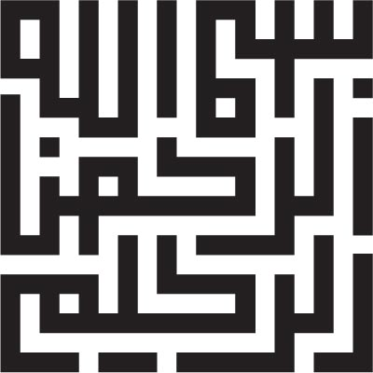
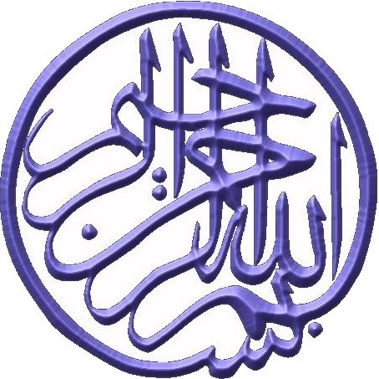
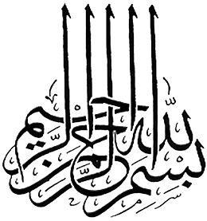
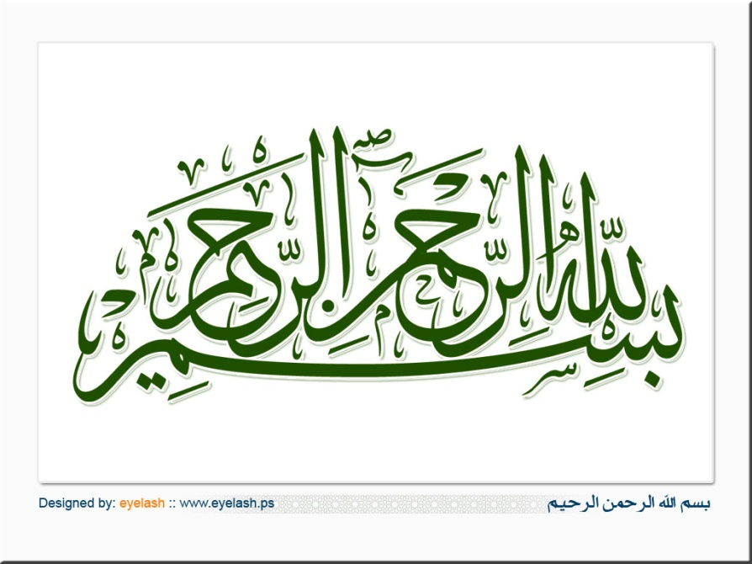
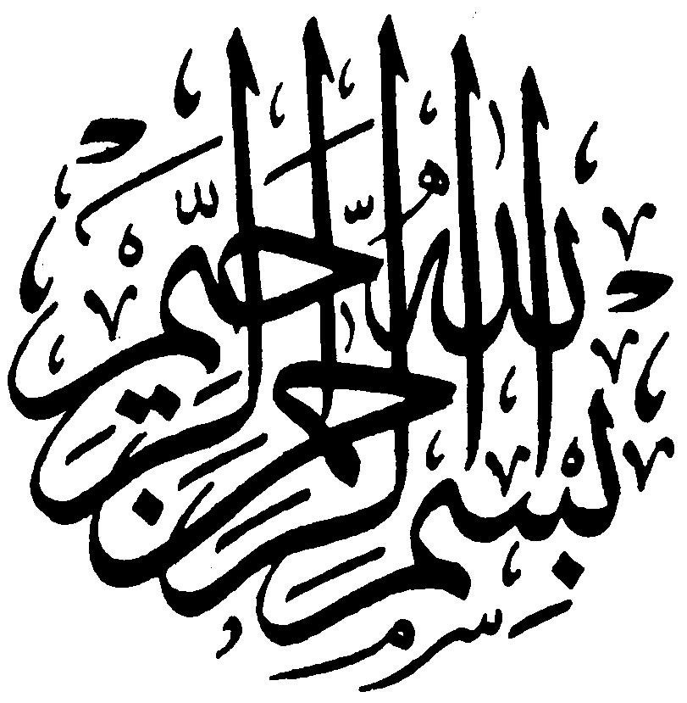
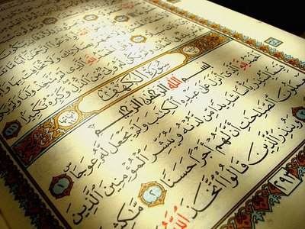
back

Slide 16
back

