Slide 1
The Message of
Jesus Christ
Prepared by:
Mohammed A. Al-Abdulhay
Petroleum Engineer – Saudi Aramco
0503925046, miswatch@hotmail.com

Slide 2
Introduction
There is a God; (The Lord, Master, Sustainer, Creator, Nourisher…).
God sent many prophets to convey His instructions to mankind.
Same God→ Same Message
Adam, Noah, Abraham, Moses, Jesus and finally Muhammad.
Jesus taught his people to follow the teaching of previous prophets, likewise.
 The followings are some examples of teachings which all prophets including Jesus followed.
 However, most of these teachings were revived in the final message of Islam by Prophet Muhammad and remain as a fundamental part of Muslim practices until today.

Slide 3


Greetings
Jesus' Way
Jesus greeted his followers by saying “Peace be upon you”. This greeting was according to that of the prophets, as mentioned in the books of the Old Testament.
John 20:19
“Jesus said to them again, ‘Peace be with you’.
Islamic View
Islam instructs all who enter homes to give greetings of peace. God instructs the believers to greet each other with peace: Whenever Muslims meet each other, they use this greeting.
Quran (6:54)
“When those who believe in my signs come to you, greet them: Peace be upon you.”

Slide 4
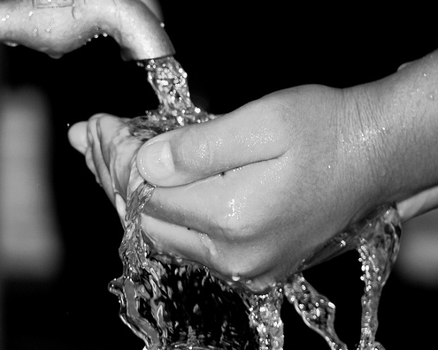
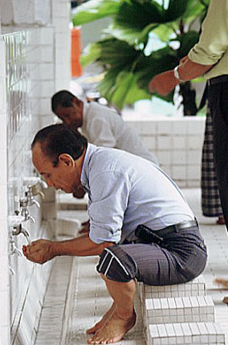
Ablution before Prayer
Jesus' Way
Prior to making formal prayer, Jesus used to wash his limbs according to the teachings of the Torah.
Exodus 40:30-31
“And he set the laver between the tent of meeting and the altar, and put water in it for washing, with which Moses and Aaron and his sons washed their hands and their feet.... as the Lord commanded Moses.”
Islamic View
Ablution for prayer is prescribed as follows
Quran (05:06)
“O you who believe, when you intend to pray, wash your faces and fore-arms up to the elbows, wipe your heads and wash your feet up to the ankles ...”

Slide 5
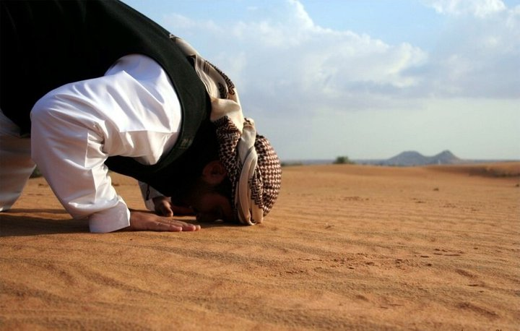
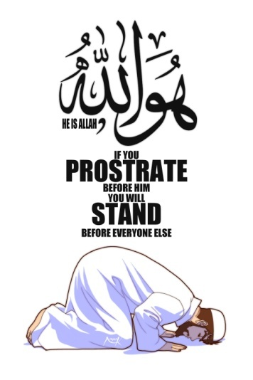
Prostration in Prayer
Jesus' Way
Jesus is described in the Gospels as prostrating during prayer. Prophet Abraham, Moses, Aaron , Joshua, Elijah are recorded to have fallen on face in prayer (worship).
Matthew 26:39
“And going a little farther he fell on his face and prayed, ‘My Father, if it be possible, let this cup pass from me; nevertheless, not as I will, but as thou wilt.”
Islamic View
God instructed the believers to bow down in worship to Him.
Quran (76:26)
“Remember the Name of your Lord in the morning and evening, and prostrate to Him and glorify Him for a long time nightly.”

Slide 6
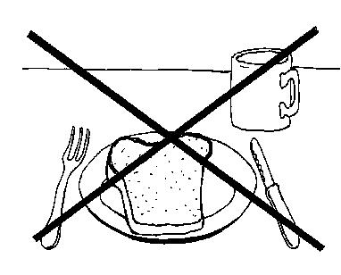

Fasting
Jesus' Way
According to the Gospels, Jesus fasted for 40 days. This was in accordance with the practice of the earlier prophets. Moses is also recorded to have fasted.
Matthew 4:2:
“And he fasted forty days and forty nights, and afterward he was hungry
Islamic View
In Islam, the believers are instructed to observe regular fasting.
Quran (2:183)
“O you who believe, fasting is prescribed for you as it was prescribed for those before you, in order that you may become pious.”

Slide 7
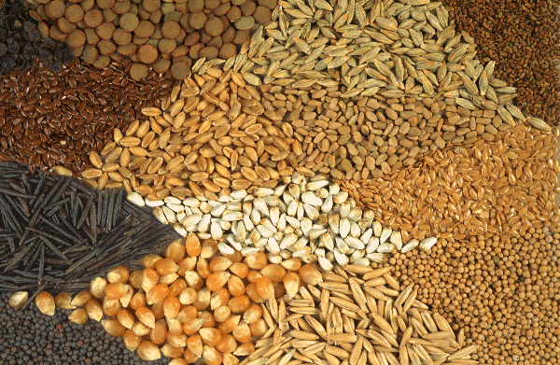

Charity
Jesus' Way
Jesus confirmed the payment of charity, known as “(tenth)”, which was required from the annual harvest to be given back to God in celebration.
Deuteronomy 14:22
“You shall tithe all the yield of your seed, which comes forth from the field year by year.”
Islamic View
The system of compulsory charity (in Arabic, zakah) is well organized, with different rates for cash and precious metals than that for agricultural products and cattle.

Slide 8
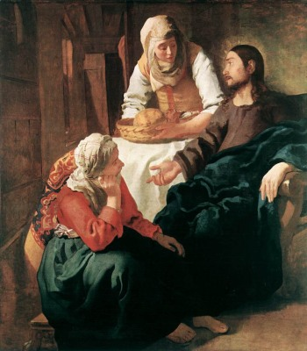
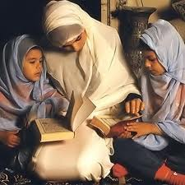
Veiling
Jesus' Way
The women around Jesus veiled themselves according to the practice of the women around the earlier prophets. Their garments were loose and covered their bodies completely, and they wore scarves which covered their hair
In Genesis 24:64-5
“And Rebekah lifted up her eyes, and when she saw Isaac, she alighted from the camel, and said to the servant, ‘Who is the man yonder, walking in the field to meet us?’ The servant said, ‘It is my master.’ So she took her veil and covered herself.”
Islamic View
The believing women are instructed to cover their charms and wear veils on their heads and chests.
Quran (24:31)
“Tell the believing women to lower their gaze and protect their private parts and not to expose their adornment, except only what normally shows, and to draw their head-scarves over their bosoms...”

Slide 9


Polygamy
Jesus' Way
There is no record of Prophet Jesus opposing polygamy.
Prophet Abraham had (2) wives, according to Genesis 16
Prophet David had (2) wives, according to Samuel 27:3
Prophet Solomon had (700) wives, according to 1st Kings 11:3
Prophet Jacob had more than one wife
Islamic View
Islam limited polygamy to a maximum of four wives. Required fair and justice treatment among them.
Quran (4:3)
“Marry of the women that please you two, three or four. But if you fear that you will not be able to deal justly, then marry only one”

Slide 10


Alcohol
Jesus' Way
Jesus abstained from alcoholic drinks and never drank it according to the instructions recorded.
Numbers 6:1-4
“And the Lord said to Moses, ‘Say to the people of Israel, When either a man or a woman makes a special vow, the vow of the Nazirite to separate himself to the Lord, he shall separate himself from wine and strong drink
Islamic View
This prohibition has been preserved in the final revelation .
Quran (05:90)
“O you who believe, wine, gambling, sacrificial altars, and divination are an abomination of Satan’s handiwork, so avoid them in order to be successful

Slide 11
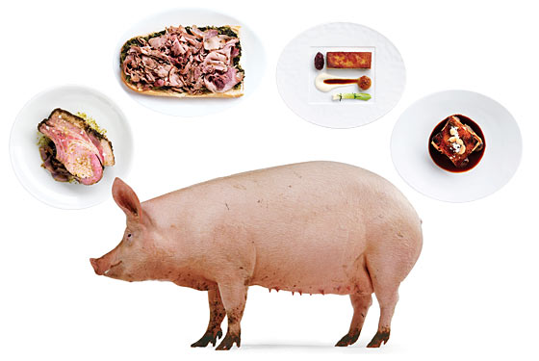
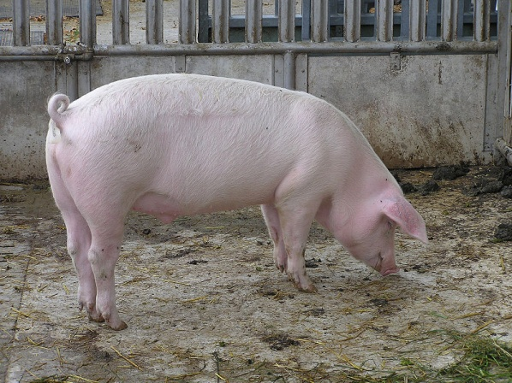
Pork
Jesus' Way
Jesus did not eat pork (swine). He followed the laws of Moses who did not eat pork too.
Leviticus 11:7-8
“And the swine, because it parts the hoof and is cloven-footed but does not chew the cud, is unclean to you. Of their flesh you shall not eat, and their carcasses you shall not touch; they are unclean to you.”
Islamic View
In Islamic law, pork (swine) and its products are prohibited.
Quran (02:173)
“He has only forbidden you animals which die of themselves, blood, swine …….

Slide 12
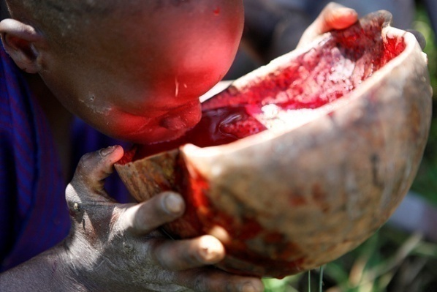
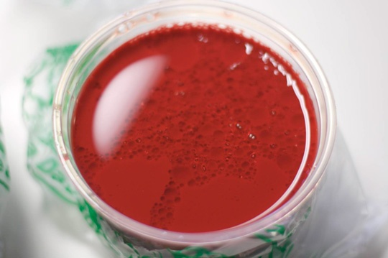
Blood
Jesus' Way
Jesus also did not eat anything containing blood or eat blood. God instructed Prophet Moses in the Torah.
Deuteronomy 12:16
“Only you shall not eat the blood; you shall pour it upon the earth like water,”
Islamic View
This prohibition has been preserved in the final revelation.
Quran (06:145)
“Say (O Muhammad): I do not find in what has been revealed to me anything forbidden to be eaten by one who wishes to eat, except for animals which die of themselves, flowing blood and swine flesh, for they are indeed impure.”

Slide 13
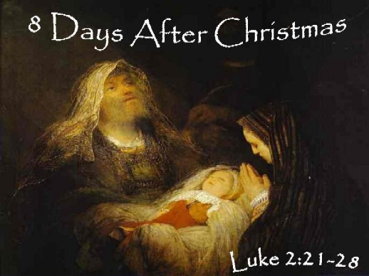
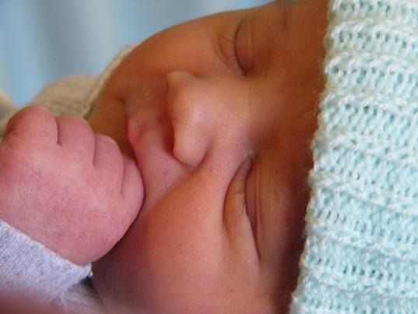
Circumcision
Jesus' Way
Jesus was circumcised according to the Old Testament, this tradition began with Prophet Abraham.
Luke 2:21
“And at the end of eight days, when he was circumcised, he was called Jesus, the name given by the angel before he was conceived in the womb.”
circumcision is a part of Jesus’ way. However, today most Christians are not circumcised
Islamic View
All Muslims are circumcised following the teaching of Jesus (Islam).
Prophet Muhammad said:
“There are five practices which constitute the prophetic way; circumcision,…….

Slide 14
Conclusion
Jesus Christ, invited his people to the same message of old prophets .
Prophet Muhammad came with same message of Jesus Christ .
Jesus Christ before his departure, he informed his followers of the last prophet, Muhammad who would come after him, and instructed them to follow his teachings.
In the generations after Jesus’ departure from this world, his teachings were distorted.
Six centuries later, the laws of Jesus were revived in their pure and final form (Islam).
Nowadays, only Muslims t actually follow Jesus and his true teachings.
Love, and respect of Jesus Christ is an article of faith in Islam.
Thank you
By: Engr. Mohammed Al-Abdulhay, Tel. 0503925046, email: miswatch@hotmail.com

