Slide 1

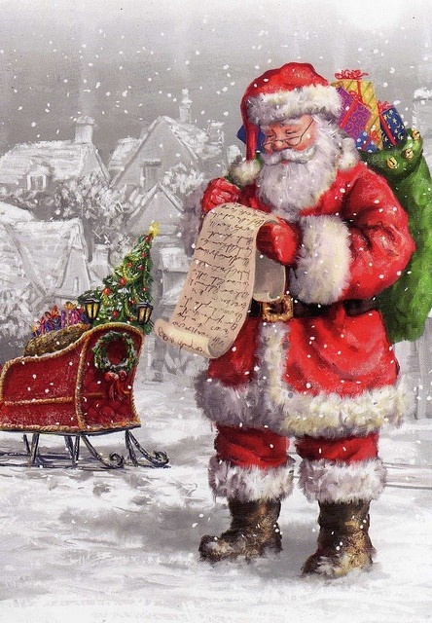


Slide 2


What Did Jesus Say
About
Christmas ?

Slide 3



The Christmas Experience

Slide 4

The Christmas Experience
The perfect Christmas tree is bought. Adorned with ornaments and glittering with tinsel, it stands by the window. The stores are crammed with shoppers hunting for presents and the little ones anxiously waiting for Santa.
Busy with Christmas fever, wonder did you ever, did the Bible or Jesus made any injunction on Christmas ever?
Ponder upon the following analysis on Christmas, and the Truth will become clearer and clearer.

Slide 5
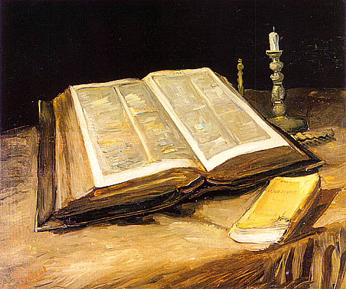

Does Christmas have Biblical Evidence?

Slide 6



Does Christmas have Biblical Evidence?
The word 'Christmas' does not exist in the Bible. The Bible has closed lips on the entire feast of Christmas, with one exception, the decoration of a tree. The Bible itself criticizes the decoration of the (Christmas) trees:
"The customs of the people are worthless, they cut a tree out of the forest, and a craftsman shapes it with his chisel, they adore it with silver and gold, they fasten it with hammer and nails so it will not totter “
(Jeremiah 10-3,4).

Slide 7

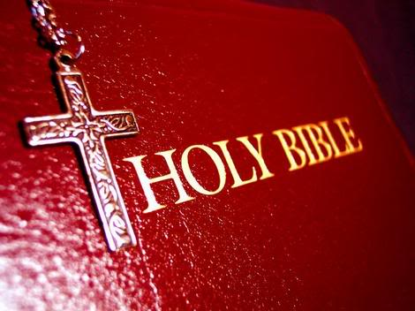
European Pre-Christian pagans superstitiously believed that the green trees had special protective powers. In fact the use of the Christmas tree began only in the 17th century in Strasbourg, France and from there it spread to Germany, Britain and then to the U.S.
“ Tree worship was a common feature of religion among the Teutonic and Scandinavian peoples of northern Europe before their conversion to Christianity … German settlers brought the Christmas tree custom to the American colonies in the 17th century. By the 19th century its use was quite widespread “ . (Compton's Encyclopedia, 1998 Edition)

Slide 8

Was Jesus born on Dec. 25 ?

Slide 9

Was Jesus born on Dec. 25 ?
Neither the date 25th Dec. nor any other date on Jesus' birth is mentioned in the Bible. It was not until the year 530 C.E. that a monk, Dionysus Exigus, fixed the date of Jesus' birth on Dec. 25th. . "He wrongly dated the birth of Christ according to the Roman system (i.e., 754 years after the founding of Rome) as Dec. 25, 753". (Encyclopedia Britannica, 1998 ed.) This date was chosen in keeping with the holidays already indoctrinated into pagans beliefs.
Roman pagans celebrated Dec. 25th as the birth of their 'god' of light, Mithra.

Slide 10


Was Jesus born on Dec. 25 ?
"In the 2nd century A..D., it (Mithraism) was more general in the Roman Empire than Christianity, to which it bore many similarities " ( The Concise Columbia Encyclopedia, 1995 ed. Other pagan 'gods' born on Dec. 25th are: Hercules the son of Zeus (Greeks); Bacchus, 'god' of wine (Romans); Adonis, 'god' of Greeks, and 'god' Freyr
of Greek Roman pagans.

Slide 11
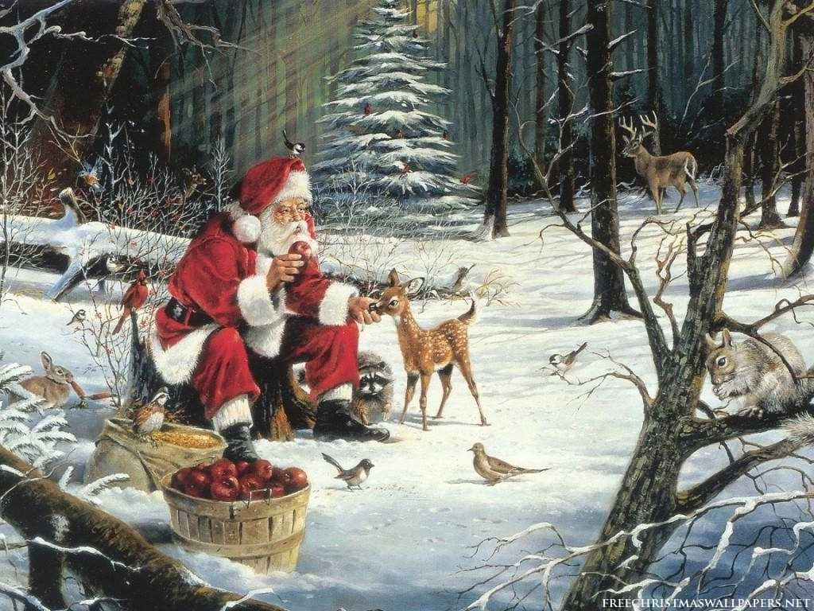
What about Santa Claus ?! ..

Slide 12
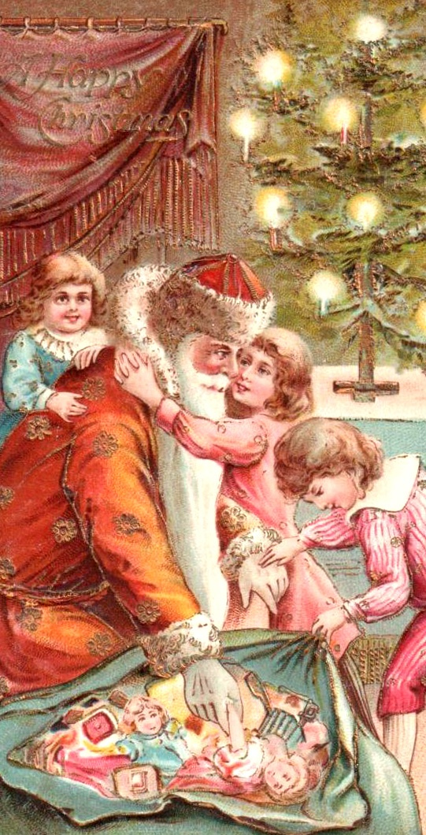
What about Santa Claus ?
If aliens descended on earth during the Christmas season, they would undoubtedly believe Christmas as being Santa's birthday. The words 'Santa Claus', appear nowhere in the Bible.

Slide 13


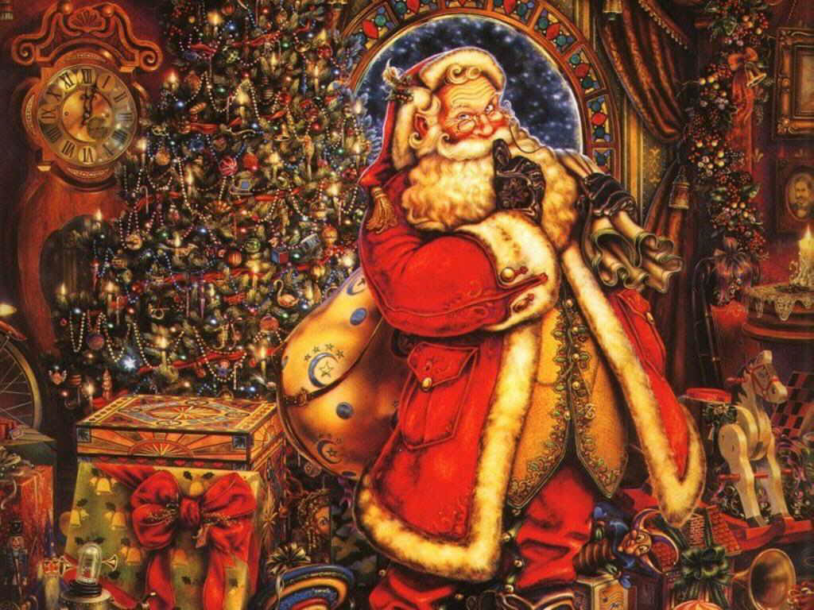
What about Santa Claus ?
However, Saint Nicholas (Santa Claus) was a real person, a bishop, who was born 300 years after Jesus. According to legend, he was extremely kind and set out at night to bring presents to the needy. After his death on 6th of Dec., school boys in Europe began celebrating a feast day each year .
Queen Victoria later changed the celebration date from Dec.
6th to Dec. 24th eve .

Slide 14

Did Jesus or his Companions Celebrate Christmas ?

Slide 15

Did Jesus or his Companions Celebrate Christmas ?
If Jesus meant his followers to celebrate Christmas, he would have practiced it himself and enjoined it on his followers. There is no mention in the entire Bible that any of his followers ever celebrated Jesus' birthday like Christians do today.
“ The church did not observe a festival for the celebration of the event of Christmas until the 4th century " (Grolier's Encyclopedia)

Slide 16

Did Jesus or his Companions Celebrate Christmas ?
Thus we see that neither the Bible nor Jesus and his companions say anything about the celebration of Christmas which currently involves fanfare, commercialization, and extravagant spending, devoid of any spiritual relevance.
We'll now analyze the real person of Jesus (peace be upon him), in the light of the Bible and Islam ...

Slide 17

What did Jesus Say about Himself ?

Slide 18

What did Jesus Say about Himself ?
In many places in the Bible, Jesus, referring to himself as a Prophet said:
"A Prophet is not without honor, save in his own country, and in his own house" (Matthew 13:57),
"Nevertheless I must walk today and tomorrow and the day following, for it cannot be that a Prophet persists out of Jerusalem". (Luke 13:33).

Slide 19

Jesus Received God's Revelation

Slide 20

Jesus Received God's Revelation
Similarly, Jesus Christ too, as a Prophet, received revelations from God: "But now you seek to kill me, a man that had told you the truth, which I heard of God" (John 8:40)

Slide 21


Jesus Prayed to his God
"And when he (Jesus) had sent the multitudes away, he went up into a mountain apart to pray“
(Matthew 14:23)
Obvious question: If Jesus was God, who was he praying to ?

Slide 22


Jesus put himself Equal to other Humans
Jesus put himself equal to other humans in the eyes of God.
"My father and your father, my God and your God" (John 20:17)
God does not have a God, But Jesus had a God! Moreover, the gospel writers referred to Jesus Christ (peace be upon him) as the 'son of man' about 85 times in the Gospels, and never once did he explicitly called himself 'God', or 'God the Son', or 'The Begotten Son of God'.

Slide 23

Jesus Preached God's Oneness
Jesus Christ, as a true Prophet of God, taught monotheism. When asked, 'What is the first of all commandments', Jesus replied:
"...The first of all the Commandments is, Hear O Israel; the Lord our God is One Lord" (Mark 12:29)
"And this is life eternal, that they might know thee the only true God and Jesus Christ whom thou has sent" (John 17:3)

Slide 24

Prophets of God

Slide 25

Prophets of God
God, by his mercy, sent numerous Prophets throughout history to all nations as guides and role models. Some of the prophets were Noah, Abraham, Ishmael, Isaac, Jacob, Moses, Jesus and the Last Prophet Muhammad (peace be on all of them). They all came with the same basic message, which is the Oneness of God, without any partners, sons or daughters ...

Slide 26
This Oneness of God in its complete essence, preached by all prophets, was later distorted by some segments of humanity and naming these 'distortions' as 'religions', they left the worship of one true God and replaced it with worshiping humans, cows and fire. To purify humanity, God sent His last Prophet, Muhammad (peace be upon him) as a guide for all mankind and through him revealed in His last Messge, The Quran :
“ They have adopted their scholars and monks as lords besides God and (also) Christ, the son of Mary, although they have been ordered to serve only God alone. There is no god but Him. Glory be to Him ! He is beyond what they associate (with Him) ....
" (Quran 9:31)

Slide 27
This utmost obedience and worship to one God, in its truest sense forms the basis of Islam. The entire Quran has been committed to memory by millions of Muslims around the world and preserved by God Himself from any interpolations, unlike previous scriptures, to provide guidance for all ages .

Slide 28

What Does Islam Teach ?

Slide 29

What Does Islam Teach ?
Islam calls humanity to the service of the One, Omnipotent Creator
( ‘ Allah ' in Arabic ) . Islam teaches the oneness of mankind in the eyes of God regardless of superficial differences such as race & nationality . In Islam there is no superiority of whites over blacks or vice versa . Anything that disrupts society's harmony and deviates humans from worshiping one true God is disliked in Islam.

Slide 30
What Does Islam Teach ?
Thus Islam recognizes the evils of alcohol, drugs, premarital sex, gambling etc. and advises humans to stay away from these Satan's handiwork . Islam further provides detailed instruction about a person's relationship with God, with his family and the society. Thus no aspect of a person's life is outside of the guidance provided by God .

Slide 31

Born Sinless !
Islam teaches that every child is born sinless with a pure heart and an inner instinct to realize the oneness of God . It is the parents or the environment that deviates this child to associate partners with God (in the form of multiple gods) or to reject God altogether.

Slide 32

.. No Mediator ..
There is no mediator between God and man . There is no need of one, for God, the All knowing who can listen and answer our sincere prayers regardless of our state and place.
Salvation comes through submitting to the pure belief in One God and following His guidance as revealed in the Quran, and not through the vicarious sacrifice (murder) of an innocent human being. Thus Islam is a rational religion based on justice and self accountability, and not on unjust and mysterious doctrines formulated by humans. Islam provides solutions to all the ills plaguing humanity. An example of Islam's stand on racial justice is provided below.

Slide 33

Islam Dispels Racism

Slide 34
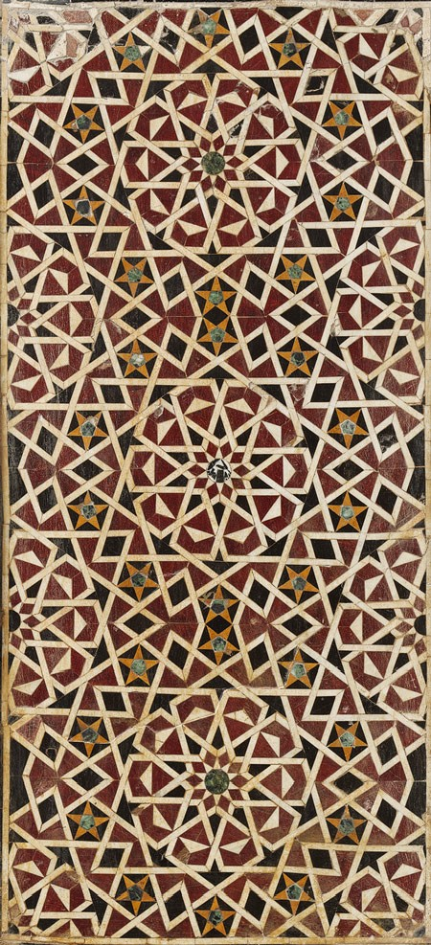
Islam Dispels Racism
One person's superiority over another is not based on his race, economic status or nationality but on his God-Consciousness and purity of character. God proclaims in the Quran :`“ O mankind ! We have created you from a single (pair) of a male and female, and made you into nations and tribes, that you may know each other and not that you may despise each other. Verily the most honored of you in the sight of God is the most righteous ..." (49:13) .

Slide 35

Likewise Prophet Muhammad (peace be upon him) proclaimed: “No Arab has any superiority over a non-Arab, nor does a non-Arab have any superiority over an Arab. Nor does a white man have any superiority over a black man, or the black man any superiority over the white man. You are all the children of Adam, and Adam was created from clay. "
After studying Islam, Malcolm X, became a true Muslim. He remarks:
"...America needs to understand Islam, because this is the one religion that erases from its society the race problem... "

Slide 36

The Quran was revealed in the Arabic language, but translations of its meaning are available in English and other languages for non-Arabs. Likewise Islam is not restricted to people of the east or Arabs, it is a universal religion revealed for all of mankind .
We invite all sincere humans to study Islam with an unbiased mind. Don't blindly follow the whims and paganistic influences of the environment around us . God bestowed upon us this superb mind to seek and live the truth; for we all will be accountable on the Day of Judgment for our beliefs and deeds. Don't delay your salvation .
Visit: http://www.quran.com/

Slide 37

Welcome
to
Islam ! ^_^

