Slide 1





www.islamhouse.com

Slide 2



www.islamhouse.com

Slide 3

www.islamhouse.com

Slide 4

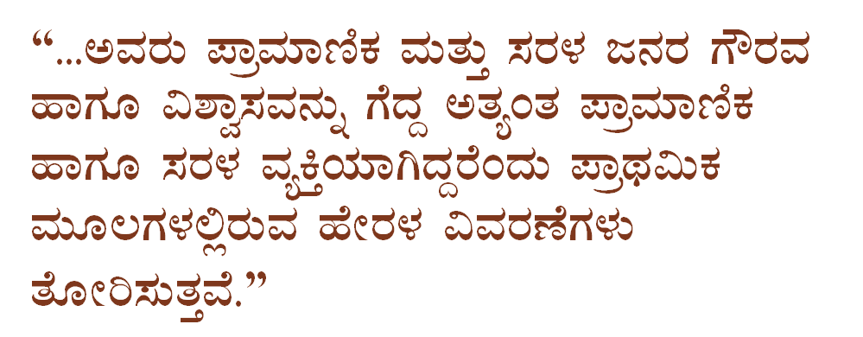

www.islamhouse.com

Slide 5
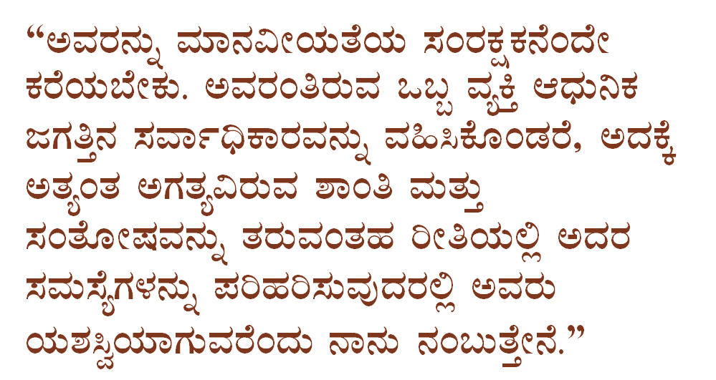

www.islamhouse.com

Slide 6





www.islamhouse.com

Slide 7


www.islamhouse.com

Slide 8



www.islamhouse.com

Slide 9
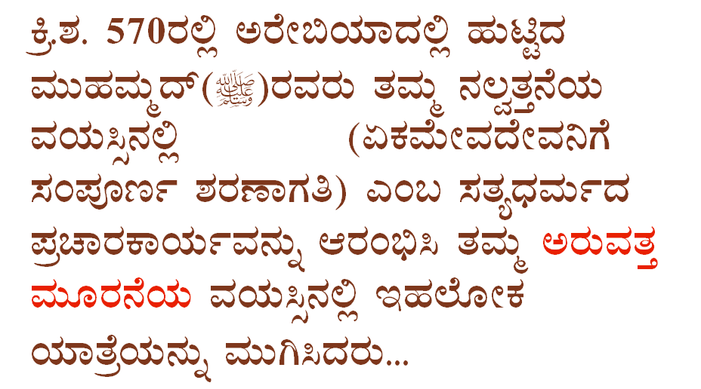

www.islamhouse.com

Slide 10
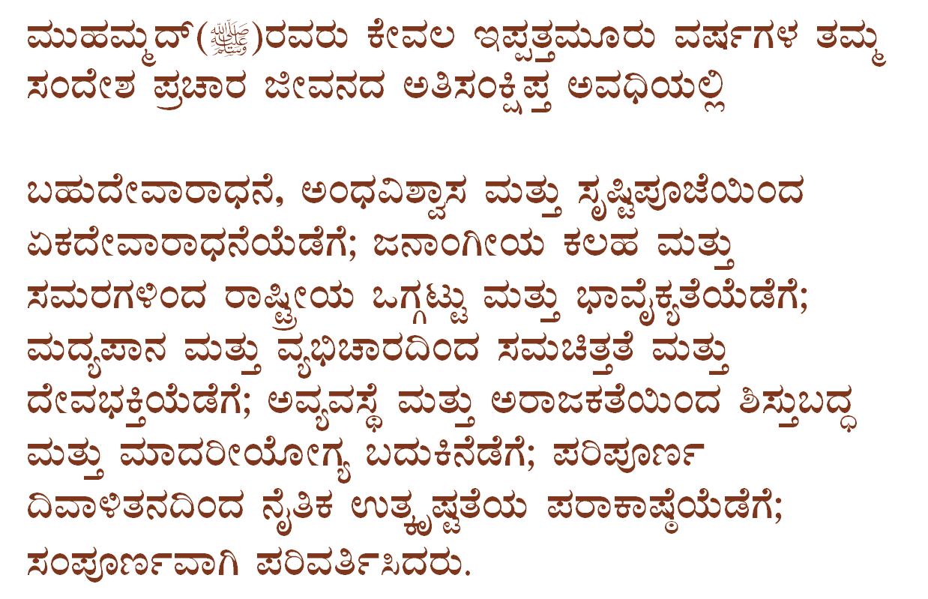
www.islamhouse.com

Slide 11

www.islamhouse.com

Slide 12





www.islamhouse.com

Slide 13



www.islamhouse.com

Slide 14




www.islamhouse.com

Slide 15
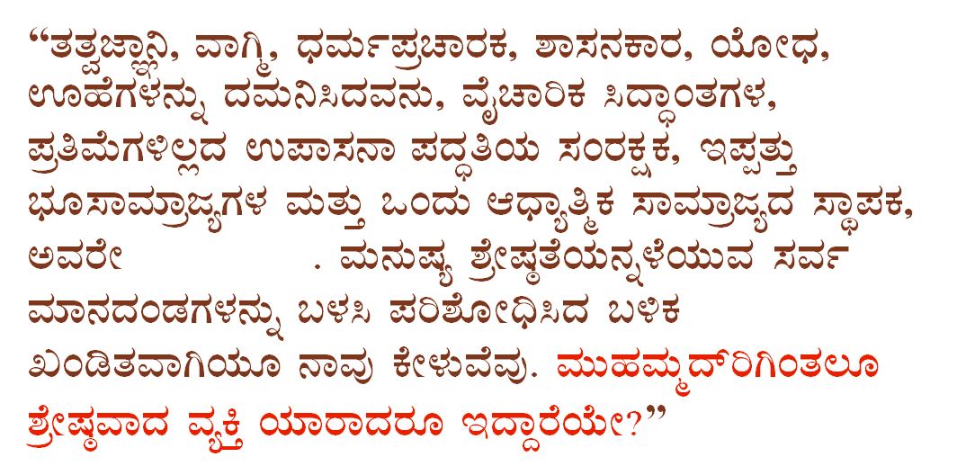


www.islamhouse.com

Slide 16


www.islamhouse.com

Slide 17



www.islamhouse.com

Slide 18

www.islamhouse.com

Slide 19
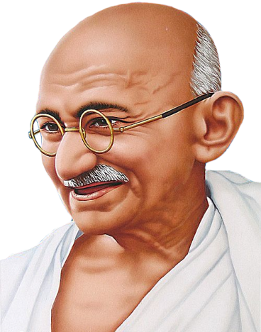

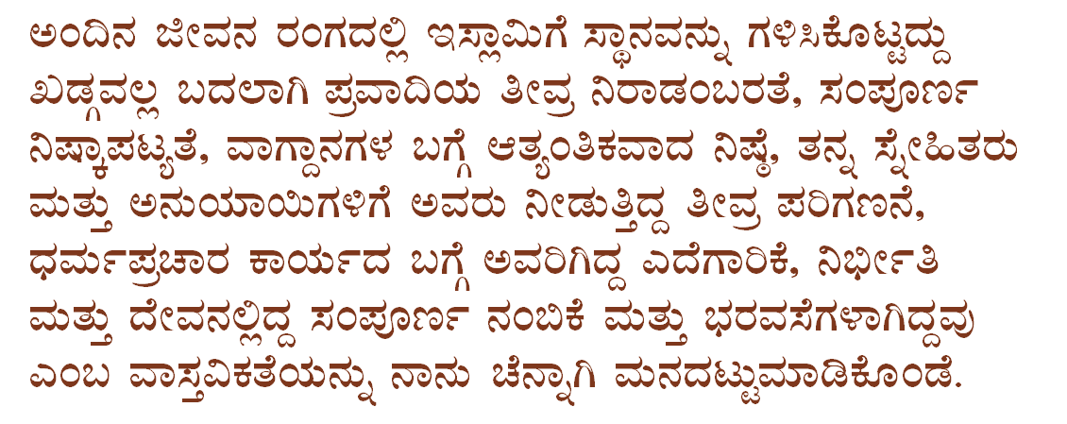
www.islamhouse.com

Slide 20



www.islamhouse.com

Slide 21

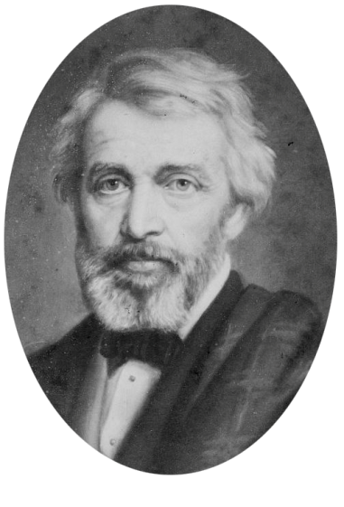
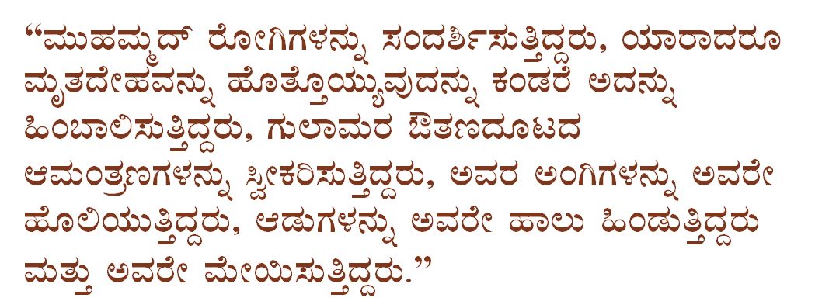

www.islamhouse.com

Slide 22



www.islamhouse.com

Slide 23


www.islamhouse.com

Slide 24

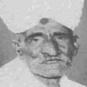

www.islamhouse.com

Slide 25
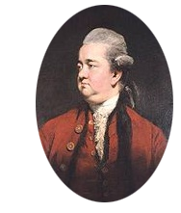




www.islamhouse.com

Slide 26


www.islamhouse.com

Slide 27
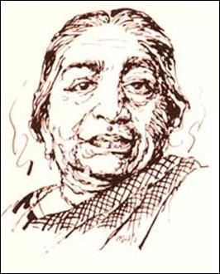
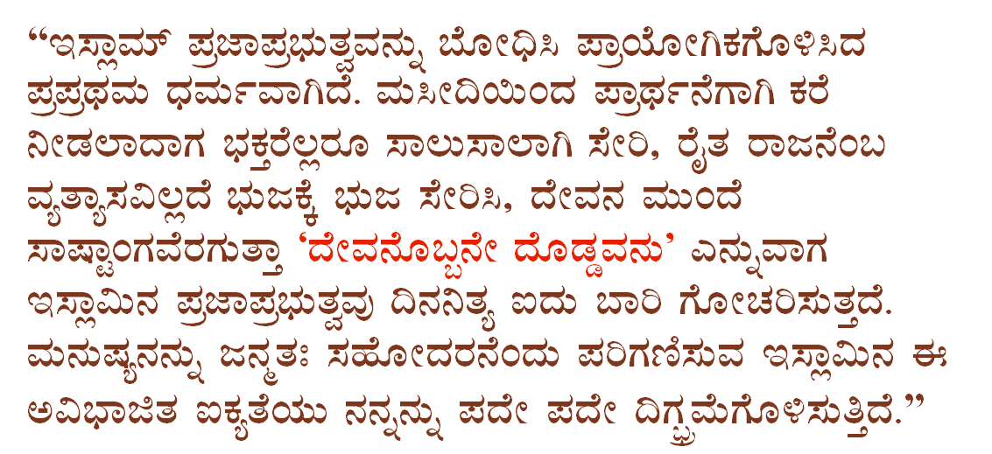

www.islamhouse.com

Slide 28

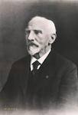

www.islamhouse.com

Slide 29





www.islamhouse.com

Slide 30





www.islamhouse.com

Slide 31

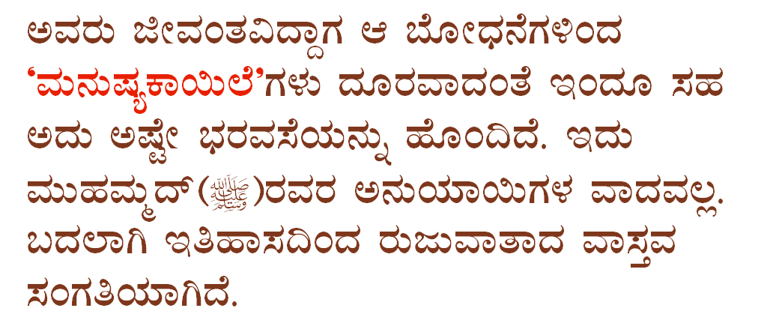
www.islamhouse.com

Slide 32

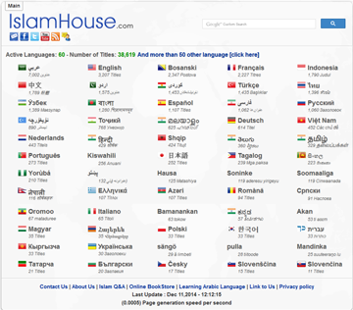

www.islamhouse.com
www.islamhouse.com

